Slide 1
Homework 1 (Discussion)
Ask one question with “why”, that you are interested in about ocean currents/anything. (問任何你有興趣的為什麼問題，可與海流無關)
Try to give an answer.

Slide 2
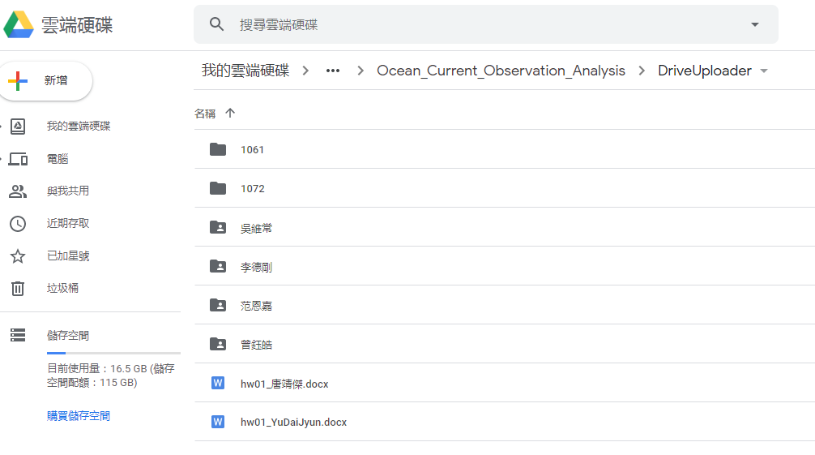
Checking your homework

Slide 3
教學進度 (期中考前) Schedule (Before mid-term)
Introduction: Why do we need to observe ocean currents?
Some basic tools for programming and scientific plotting: Matlab, Python, Julia Language, GMT, Ocean Data View (additional topics for students) & some required mathematics
Methods of observing currents: In-situ and satellite observations (1~2週)
Data and links of observations for ocean currents (1~2週)
Drifter data analysis

Slide 4
教學進度 (期中考後) Schedule (After mid-term)
4/30日週四出海實習 (海研二號，7:30am)
ADCP data analysis
Shipboard ADCP calibration (data processing for bottom-track ship velocities)
Shipboard ADCP calibration (data processing for GPS ship velocities)
Current Meters
Hydrographic (CTD, XBT, ARGO) data analysis
Wind-driven Circulation

Slide 5

上課檔案或講義連接 (選一)
http://gofile.me/3P3ad/K8rdSnYve
Or, QR-code:

Slide 6
Some basic tools & Scientific plots to study ocean currents

Slide 7
Outline
Some required mathematics (Calculus: Differential)
Some basic tools for programming and scientific plotting: Matlab, Python, Julia Language, GMT
Some scientific graphs for oceanography
Some methods of observing ocean currents (may be next week)

Slide 8
Basic calculus that we need
Differential/Derivation

Slide 9
Differential
What this mean: the differentiation of parameter q with respect to time (t)?
What is its physical meaning?

Slide 10
Physical meaning of Differential
q
The changes of q with time
q 隨著時間的變化
t

Slide 11

Speed: Application of derivation
D
t

Slide 12
Physical meaning of Differential
q
The changes of q with space-x
q 隨著1度空間的變化
x

Slide 13
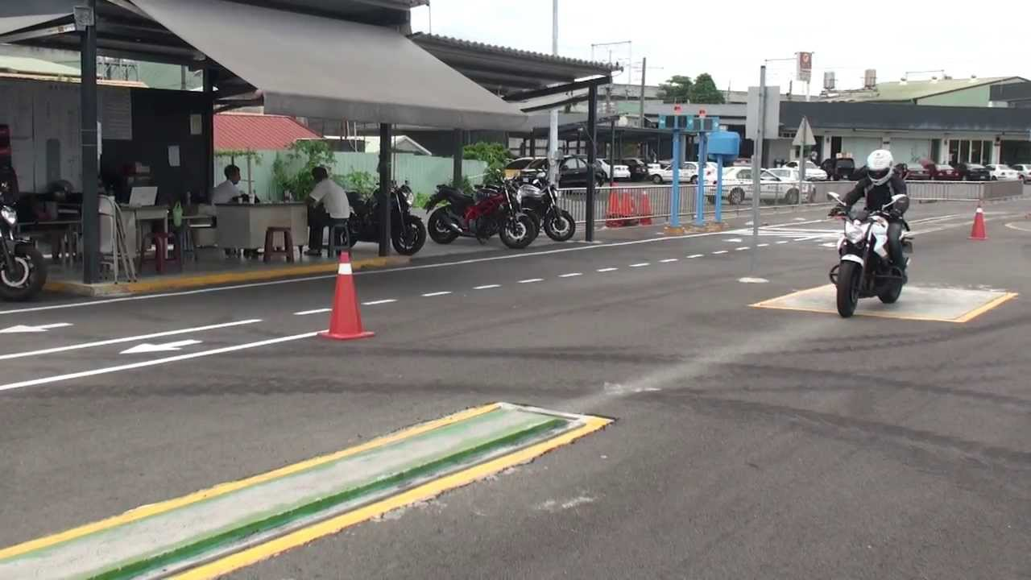
Acceleration : Application of derivation
v
x

Slide 14
Physical meaning of Differential
y
x
Incorrect notation
The changes of q with space-xy
q 隨著2度空間的變化

Slide 15
Physical meaning of Differential (Partial)
y
x
The changes of q with space-xy
q 隨著2度空間的變化

Slide 16
Some basic tools for programming and scientific plotting

Slide 17
Some basic tools for programming and scientific plotting
Coding: Matlab, Python, Julia Language, GMT
Software: Ocean Data View, SciDAVis, LabPlot, SigmaPlot, Surfer

Slide 18

Some nice links to learn the coding
https://learntocode.mathworks.com/

Slide 19

Some nice links to learn the coding
https://matlabacademy.mathworks.com/
(Recommended)

Slide 20
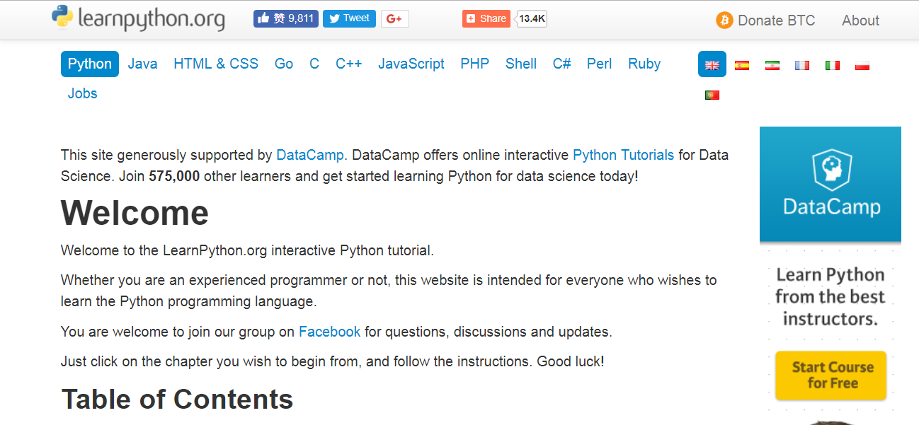
Some nice links to learn the coding
https://www.learnpython.org/

Slide 21
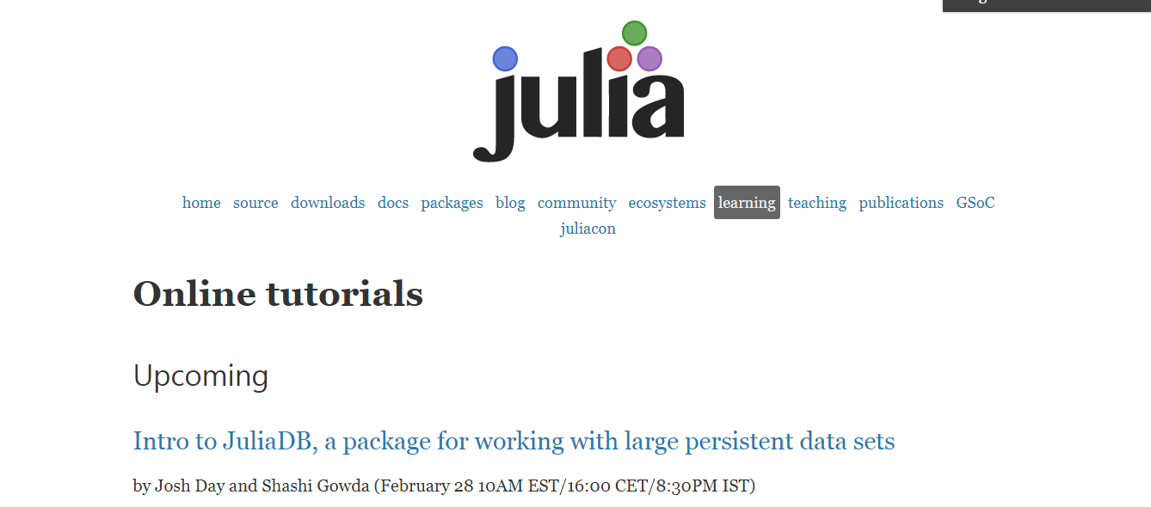
Some nice links to learn the coding
https://julialang.org/learning/ (Recommended)

Slide 22
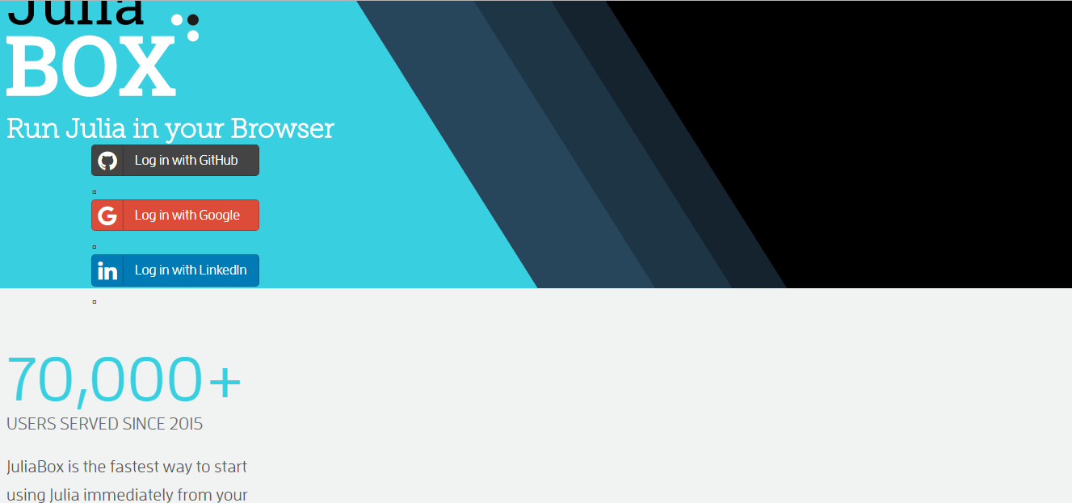
Try yourselves
Link to https://juliabox.com/
login with any Google account (gmail)

Slide 23
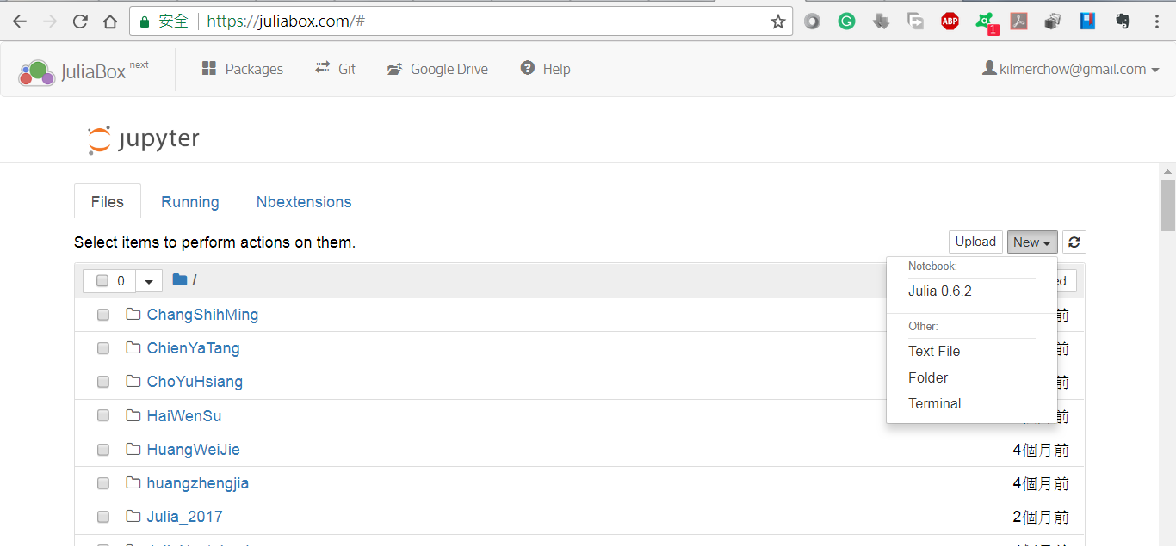

Slide 24
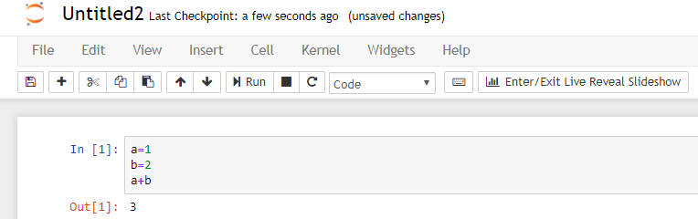

Slide 25
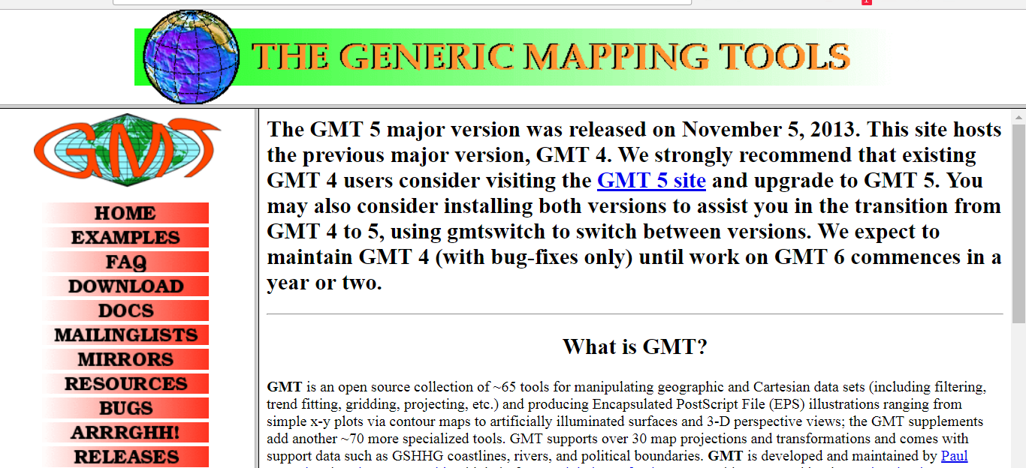
Some nice links to learn the coding
http://www.soest.hawaii.edu/gmt/
(For plotting only, no calculation can be made)

Slide 26
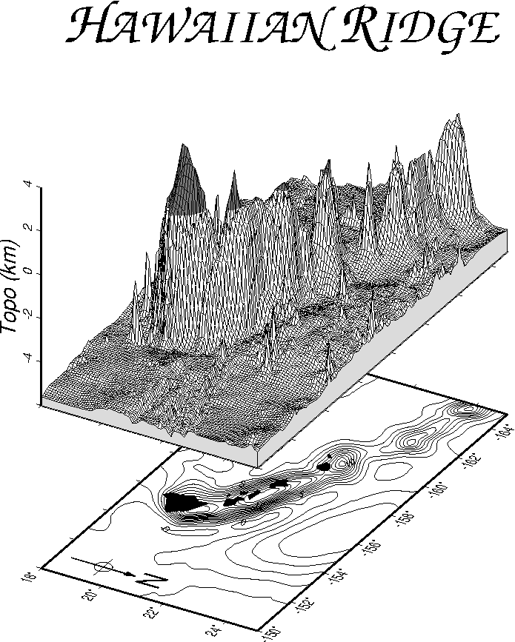
GMT

Slide 27
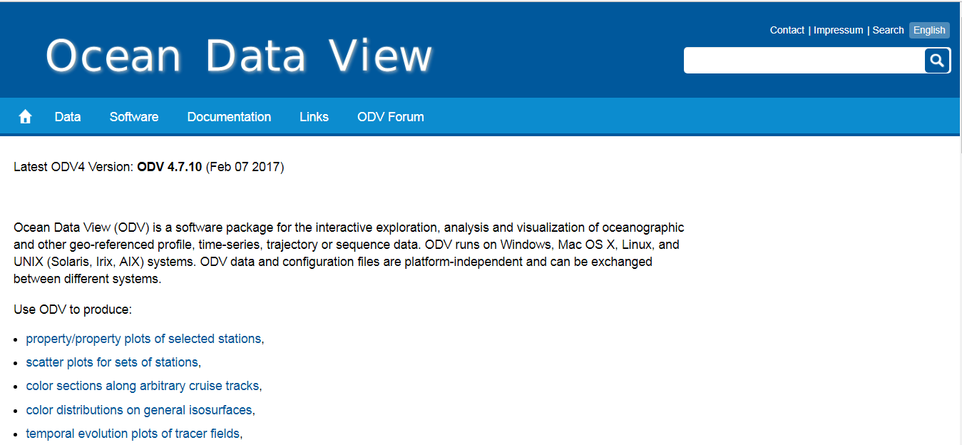
Ocean Data View
https://odv.awi.de/

Slide 28
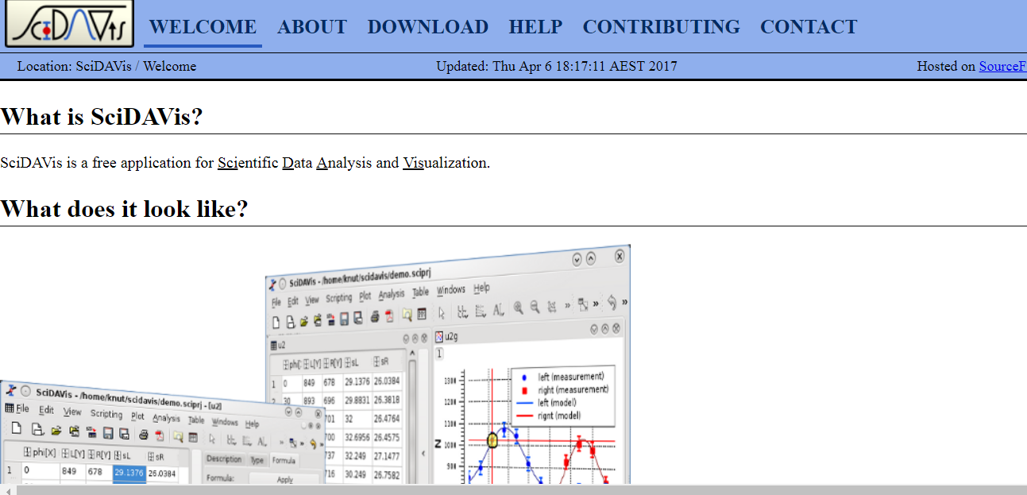
SciDAVis
http://scidavis.sourceforge.net/index.html.

Slide 29
Must
At least choose one tool to do scientific calculations and plots, and use it everyday
Recommended: Matlab* (a lot of available codes can be found for the calculations and plots), Julia Language
自學的效率(有興趣)比上課的效率更佳!
興趣能消滅任何煩惱與瓶頸

Slide 30
Why do we need at least one of those tools?
Please think.

Slide 31
Why coding?
Doing works faster to save more times
Coding will become general knowledge in future.
Coding is to communicate with a computer.

Slide 32
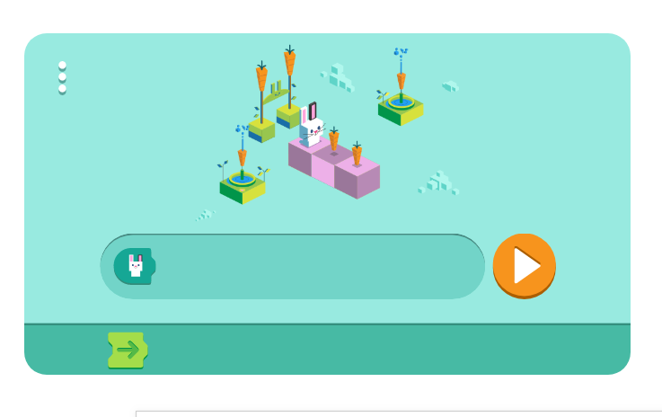
Some nice links to learn the coding (for kids)
https://www.google.com/doodles/celebrating-50-years-of-kids-coding

Slide 33
Some scientific plots to study ocean currents
Spatial Distribution
TS Diagrams
Time Series

Slide 34
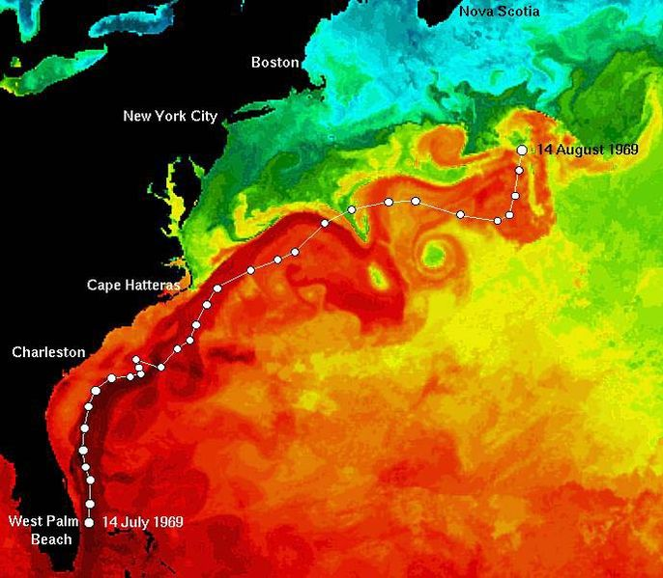
What do you see?
Notes:
I, the copyright holder of this work, hereby release it into the public domain. This applies worldwide. If this is not legally possible:
I grant any entity the right to use this work for any purpose, without any conditions, unless such conditions are required by law.
https://en.wikipedia.org/wiki/File:East_coast_sst_track.jpg

Slide 35
All data are in digits with spatial grids & temporal resolutions

Slide 36
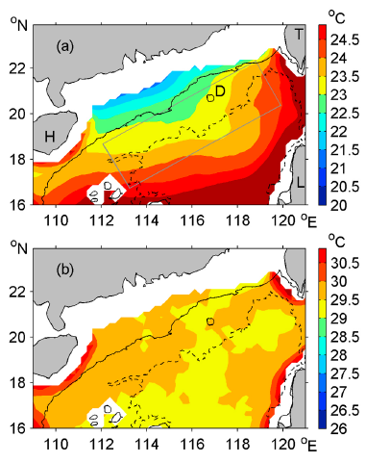
Changing in space
Which one has large changes of temperature in space? Or, which one has the large temperature gradient in space?

Slide 37
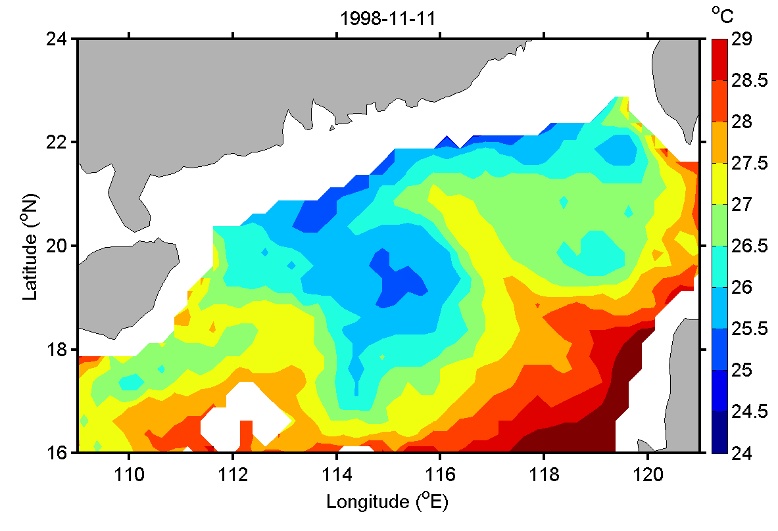
Changing in space
Which one has large changes of temperature in space? Or, which one has the large temperature in space?

Slide 38
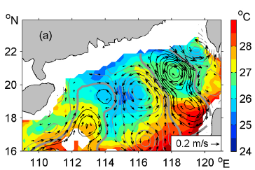

Slide 39
Advection by currents 平流

Slide 40
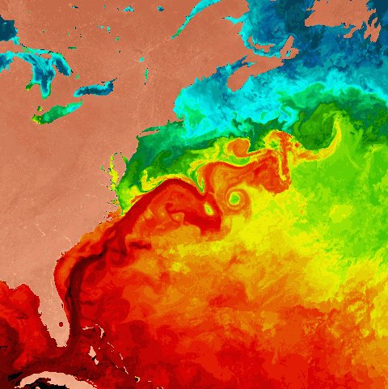
Advection by currents 平流

Slide 41
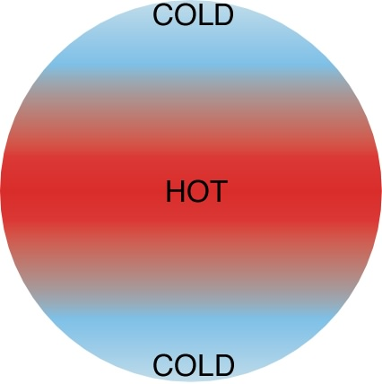
Why are ocean currents & circulation so important?
Very important for transportation!!
motion of waters carries stuff (such as mass, heat, salt, carbon, etc)
Heat transports!!!
Matter transports

Slide 42

Observe Currents
Obtain
Data
Plot
Graphs
Understand
Currents
Tools: Computers/Programs

Slide 43
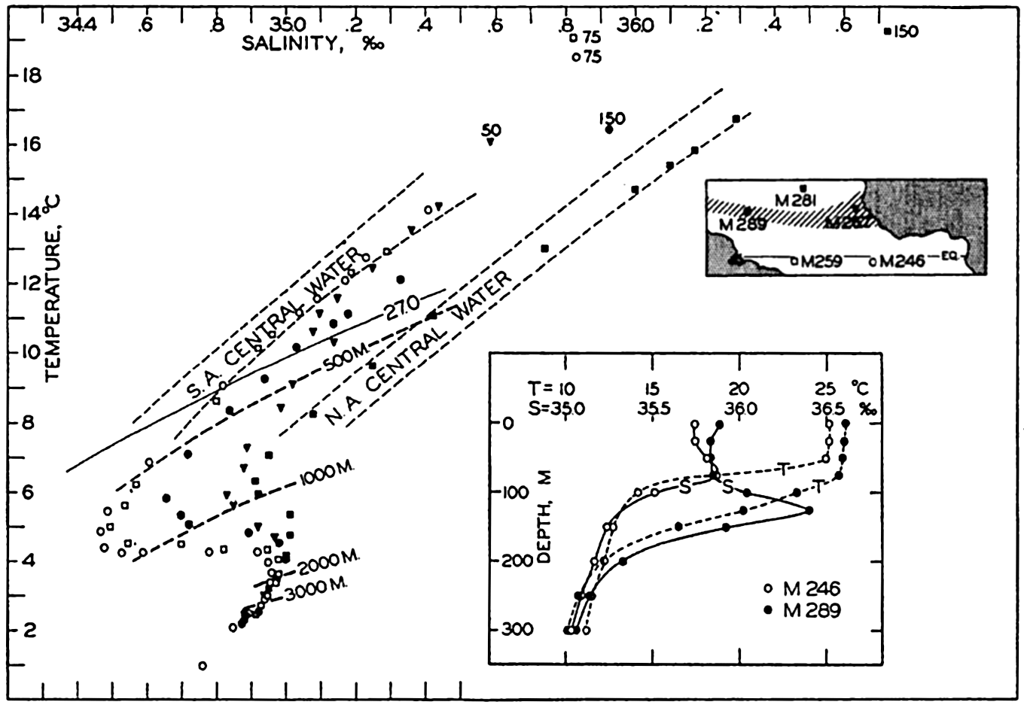
Temperature-Salinity (TS) Diagrams

Slide 44
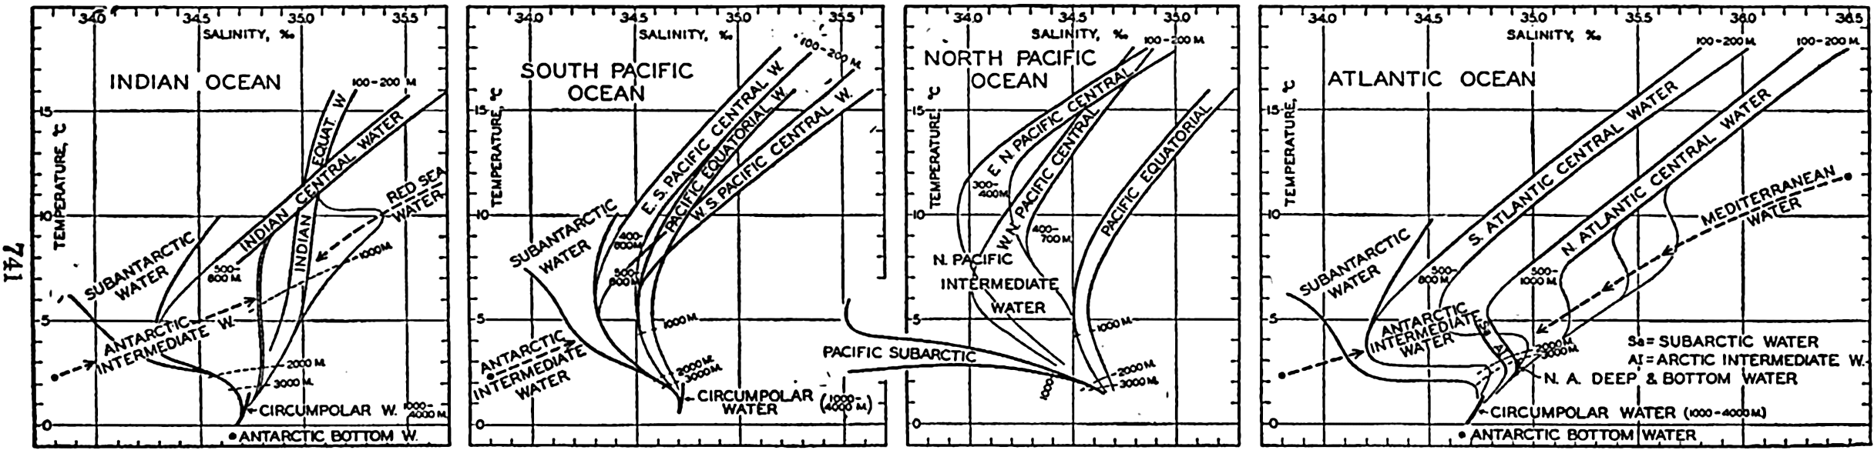
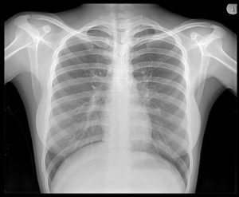
Notes:
https://publishing.cdlib.org/ucpressebooks/view?docId=kt167nb66r&chunk.id=ch15&toc.id=ch15&brand=eschol

Slide 45
What information can we learn from these TS diagrams? 分組3~4人, 用筆紙寫下討論結果後交上(註明姓名), 上臺報告
Notes:
https://publishing.cdlib.org/ucpressebooks/view?docId=kt167nb66r&chunk.id=ch15&toc.id=ch15&brand=eschol

Slide 46
Notes:
https://publishing.cdlib.org/ucpressebooks/view?docId=kt167nb66r&chunk.id=ch15&toc.id=ch15&brand=eschol

Slide 47
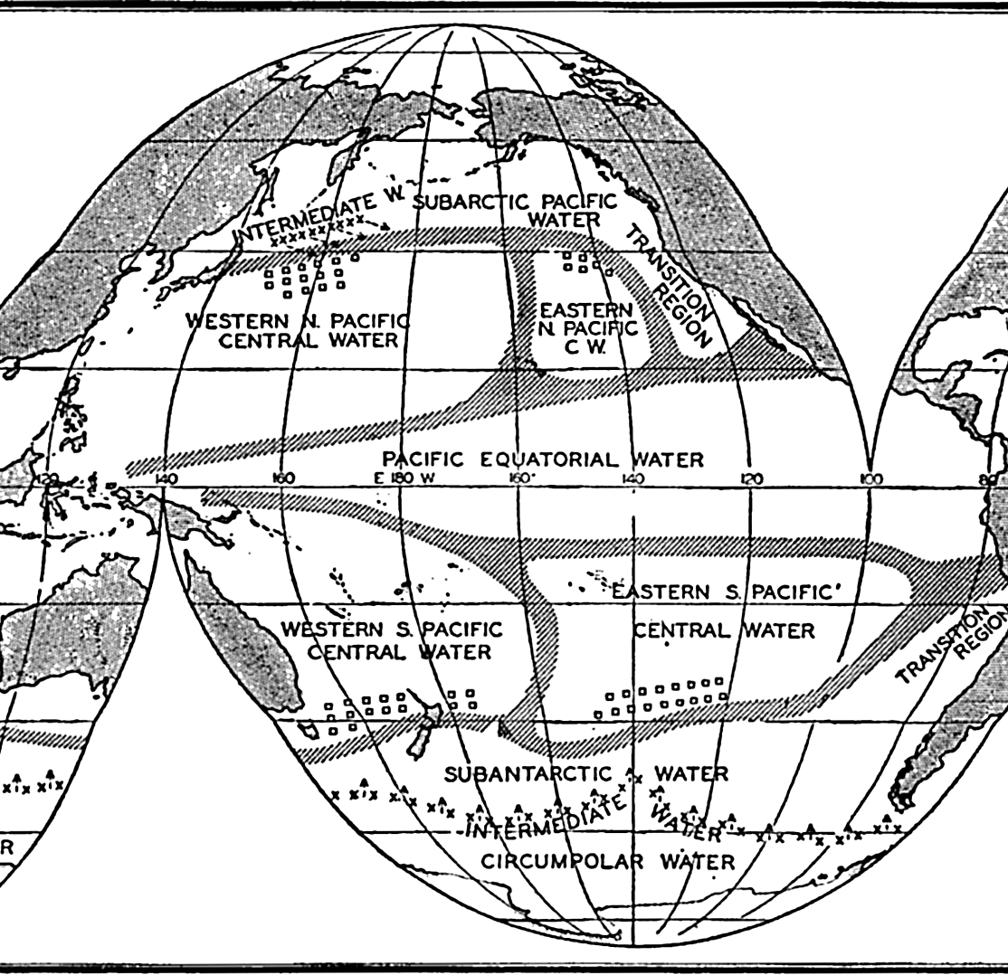

Slide 48
Homework #2 (繳交期限: 2020/3/17) 遲交以50%計算
Plot the TS diagram using the TS data (1st column is the temperature data, 2nd column is salinity data) given in the link below:
https://drive.google.com/file/d/1tg4gAYZfMwjMSsJOkWwiYIByy2X9gnQR/view
The given temperature and salinity data are obtained from an observation executed in an open ocean. Guess where the observation was executed, in the Pacific or the Atlantic. Explain why?
Send your work in a docx word file (filename: hw02_yourname.docx)
to https://driveuploader.com/upload/lVD4ycOKfP/

Slide 49
Work Flow
Choose one tool (Excel also can, for those who are familiar with programming)
Read in the TS data
Plot the TS diagram
Paste the diagram into a docx word file
Answer the question.

Slide 50
Observing the changes of natural phenomena

Slide 51
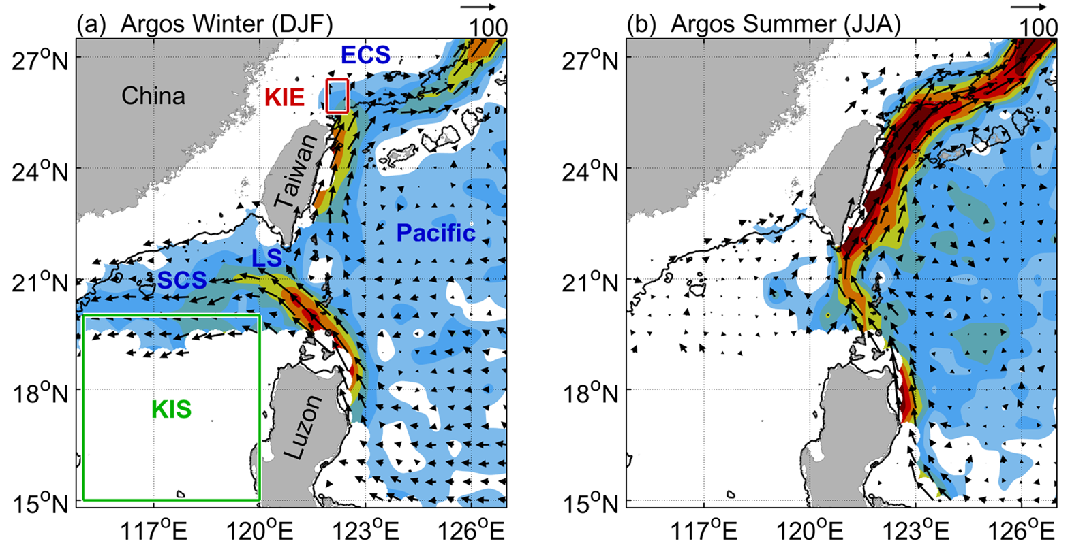
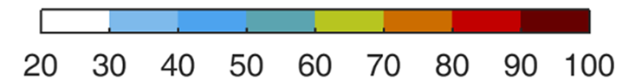
Changing in Time
Can you see the differences between these two diagrams?
Notes:
Wu, C. R., Y. L. Wang, Y. F. Lin, and S. Y. Chao (2017), Intrusion of the Kuroshio into the South and East China Seas, Sci Rep, 7(1), 7895, doi:10.1038/s41598-017-08206-4

Slide 52
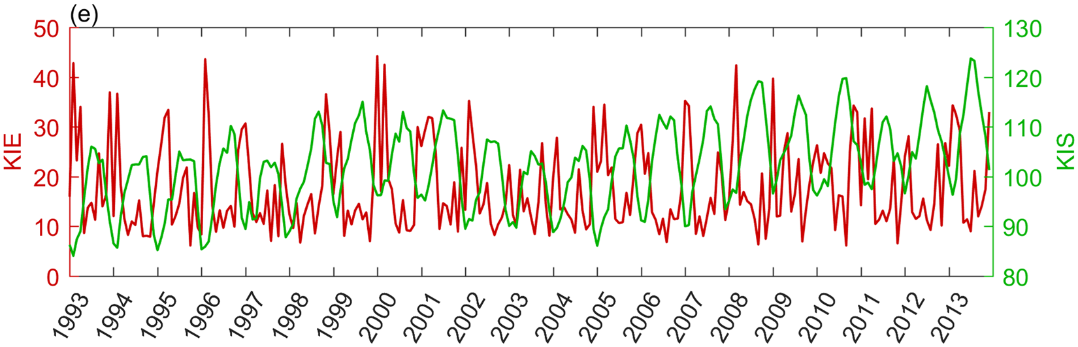


Changing in Time
Can you see seasonal variation in the time series? How to judge or interpret?
吳朝榮 (Chau-Ron Wu)

Slide 53
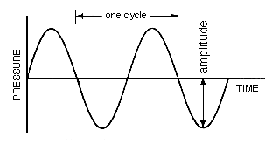
Changing in Time
When seeing at time series:
Look for peaks and troughs in the time series.
Look for amplitude
Look for repeated cycle
Any parameters
(current velocities)

Slide 54
Changing in Time
What this mean: the differentiation of parameter q with respect to time (t)?
What its physical meaning?
represents the numbers of how q changing with t
q
t
When does q change the most? (Search for the maximum dq/dt)

